Slide 1
Davidson Elementary School
Discover, Explore, Succeed….become Davidson.

Slide 2
Information parents need to know about:
MAP
Reading 3D
CogAT
EOGs

Slide 3
MAP & NWEA
Reading 3D
CogAT
EOGs

Slide 4
About NWEA assessments
Northwest Evaluation Association
Global not-for-profit educational services organization located in Portland, Oregon
NWEA partners with over 3,500 educational organizations worldwide
Provide research-based adaptive assessments, professional development, and research services
NWEA mission is partnering to help all kids learn
Allows educators to make informed decisions to promote each child’s academic growth

Slide 5
MAP
What is MAP?
When are MAP assessments given?
What is the purpose of MAP?

Slide 6
What is MAP?
Measures of Academic Progress
Computerized assessments that are adaptive in Reading and Mathematics.
Questions difficulty is based on how well students answers previous questions.
With correctly answered questions, difficulty increases
With incorrectly answered questions, difficulty decreases
In an optimal assessment, students answer half the questions correctly, half incorrectly.
Final score is an estimate of the student’s achievement level.

Slide 7
When are MAP assessments given?
MAP assessments are administered three times in a school year, Fall (September) – Winter (December) – Spring (March)
Tests are not timed, most students take about one hour to complete each MAP assessment
MAP in Primary Grades ( K & 1) may take 15 to 30 minutes to complete

Slide 8
Do all students in the same grade take the same test?
No. NWEA assessments are designed to target each student’s academic performance in mathematics and reading.
Allows each student a fair opportunity to show what he or she knows and can do.
Question difficulty is adjusted by the computer giving each student a unique assessment.

Slide 9
What is the purpose of MAP?
To measure each student’s progress or growth in school. This is growth chart!
Measure each child’s growth in mathematics and reading throughout the school year
Uses a RIT scale (Rasch unIT) or the child’s level where he/she is Ready to Instruct
Also used to chart a child’s academic growth from year to year.

Slide 10
How is a child’s assessment score (RIT) used?
Davidson Elementary School administrators and teachers use students’ RIT scores to track progress and growth this school year
Teachers use the information to guide instruction in the classroom

Slide 11
Parent privileges with MAP
Parents may not directly contact NWEA regarding student information per FERPA (Federal Educational Rights and Privacy Act)
Parents are allowed to discuss their child’s assessment results with the school administrators and classroom teachers
Davidson Elementary encourages parents to be in the know and track their child’s growth

Slide 12
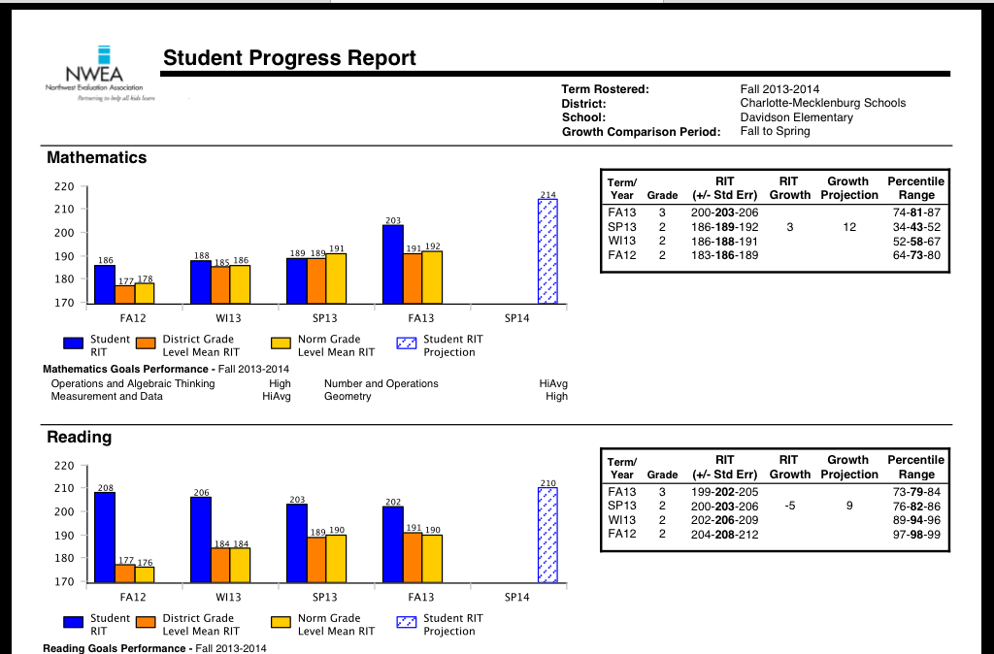

Slide 13
Parents, you should be familiar with the previous slide as it relates to your child. Please, never hesitate to contact your child’s teacher to discuss his/her MAP data at anytime during the school year. Administration is also available by appointment to further discuss your child’s success in MAP.

Slide 14
MAP
Reading 3D
CogAT
EOGs

Slide 15
Reading 3D
What is Reading 3D?
When are Reading 3D assessments given?
What is the purpose of Reading 3D?

Slide 16
What is Reading 3D?
Reading 3D is a reading record (running record) on a handheld device (ipads).
The instrument balances the assessment of foundational skills with Text, Reading and Comprehension (TRC) diagnostics, giving a complete picture of a student’s reading development.
Teachers administer the TRC to collect a variety of reading and comprehension information. The assessment involves a child reading a passage from a leveled reader to combine quick indications of early skill development with deep observations of students’ interactions with authentic texts.
Reading 3D is intended to be used for grades K-5. (DES, K-3) The assessment can be used for both determining benchmarks and for progress monitoring.

Slide 17
When are Reading 3D assessments given?
Window # 1 September 9 – October 1, 2014
Window # 2 January 7 – January 30, 2015
Window #3 April 27 – May 15, 2015
Window #1 is to take place within 15 consecutive school days, during days 1-25 of the school year.
Window # 2 is to take place within 15 consecutive school days, during days 80-105 of the school year.
Window #3 is to take place within 15 consecutive school days, during days 150-180 of the school year.

Slide 18
What is the purpose of Reading 3D?
Reading 3D is intended to be used for grades K-5. The assessment can be used for both determining benchmarks and for progress monitoring. A series of charts are provided for teachers from the assessments to provide data for grouping and to aid in instructional decision making.
Home Connection is an add-on module that supports educators’ efforts to encourage parent involvement in their children’s education.
The home connection piece enables parents to:
be aware of the school’s assessment schedule,
quickly reference the latest benchmark scores with graphical depictions
understand assessment measures with clear, understandable terms
understand specific details about a child’s strengths and weaknesses.

Slide 19
MAP
Reading 3D
CogAT
EOGs

Slide 20
CogAT
What is CogAT?
When are CogAT assessments given?
What is the purpose of CogAT?

Slide 21
What is CogAT?
Cognitive Abilities Test
It is an aptitude test used in gifted identification
Aptitude Test
Aptitude measures a student’s potential to perform. It is NOT an IQ test-which measures a student’s actual intelligence
Notes:
What is it? CogAT stands for Cognitive Abilities Test. It is an aptitude test used in gifted identification. Aptitude measures a student’s potential to perform. It is NOT an IQ test-which measures a student’s actual intelligence.

Slide 22
When are CogAT assessments given?
2nd grade screening
All 2nd graders are screened for TD certification using the CogAT in the fall
3rd-5th as needed
3rd -5th graders are also screened for TD certification using CogAT if the school-based TD committee determines there is a need beginning in November.
Notes:
When is it given? All 2nd graders are screened for TD certification using the CogAT in the fall. 3rd -5th graders are also screened for TD certification using CogAT if the school-based TD committee determines there is a need beginning in November.

Slide 23
What is the purpose of CogAT?
Scores used for TD certification
Scores from CogAT are used to determine entry into the TD program. However, there are a multitude of other uses for the score report.
Insight for classroom teachers
The data show students strengths and weaknesses in both verbal and math reasoning and provides recommendations for teachers on how to best challenge and support their students.
Notes:
What is gained? Scores from CogAT are used to determine entry into the TD program. However, there are a multitude of other uses for the score report. The data show students strengths and weaknesses in both verbal and math reasoning and provides recommendations for teachers on how to best challenge and support their students.

Slide 24
MAP
Reading 3D
CogAT
EOGs

Slide 25
EOGs
What are EOGs?
When are EOG assessments given?
What is the purpose of EOGs?

Slide 26
What are EOGs?
The End Of Grade assessments for grades 3-5.
Students are assessed in Math and Reading.
Students are assessed in Science in grade 5.
A state assessment given to all students in North Carolina.
Based on the Common Core State Standards.
Multiple choice items.

Slide 27
What are EOGs?
Math includes calculator active and calculator in-active, given on the same day with specific instructions for the students.
5th grade Math has gridded responses.
Reading – sometimes referred to as ELA (English Language Arts)
Reading includes literary and informational selections.

Slide 28
When are EOG assessments given?
The testing window for the 2014-2015 school year is May 26 – June 10
The students are generally allowed 150 minutes per subject.
Only re-tests will be given in 3rd grade currently, no determination from the state concerning grades 4 & 5 retests.

Slide 29
What is the purpose of EOGs ?
Used to determine whether a school meets it’s AMO (Annual Measurable Outcome)
Reports the number of students who are proficient in each grade level.
Becomes a part of the NC Report Card for each NC Public School.

Slide 30
How can parents be a part of these most important assessments?

Slide 31
Tips for Parents and Ways to Support
Ways to help your child prepare for assessments
Meet with your child’s teacher as often as needed to discuss progress and growth
Listen to teacher’s suggestions/activities to support your child at home
Commit to a partnership with your child’s teacher for the benefit of your child
Stress the importance to your child of always doing his/her best

Slide 32
Ways Parents Can Support Assessments
Provide a quiet, comfortable place for studying at home, on-going – everyday instruction is important all school year
Each child should get their rest on school days
Know the assessment dates, encourage extra rest and relaxation
Tired children have reduced attention spans and less tolerance of the demands of the assessments
Well rounded diet – Healthy Body = Healthy Mind
Reading at home, magazines, books - new materials expose children to vocabulary that often appears on the assessments

Slide 33
Ways Parents Can Support Language
Include children in family conversations and activities
Encourage journal or diary writing, great gifts
Letter writing to family and friends, assist with correct grammar and content
“Word of the Week”, use all week in conversations
Planning snacks or meals, writing the menu
Summarize books with favorite event descriptions

Slide 34
Ways Parents Can Support Reading
Provide opportunities for reading - books, magazines, environmental, community
Summer and/or holiday library visits
Games such as Scrabble, Scattergories, etc.
Follow your child’s interests in fiction and non-fiction
Crossword puzzles
Magazine or book club subscription

Slide 35
Ways Parents Can Support Mathematics
Simple board games, puzzles, activities that encourage math skills
Volume, weight, density – in sandbox, water in bath tub
Television shows geared towards math skills
Problem solving, let the child figure it out
Recipes in cooking, woodworking measuring
Money – spending, making change, estimating
Real life graphs, charts, data, numbers everyday

Slide 36
Thank you for supporting our mission:
Discover, Explore, Succeed….become Davidson.

